Slide 1
VA Mobility Screening and Solutions Tool (VAMSST) Training for ACUTE CARE ONLY
VHA Safe Patient Handling and Mobility VHASPHM@va.gov

Slide 2
History and Background
SPHM leaders identified the need for a mobility screening tool that could be used by all healthcare and lay persons to screen mobility for appropriate equipment selection to keep everyone safe.
The VHA Nursing Innovations Center for Evaluation (NICE) accepted the quality improvement project to develop a new tool, using BMAT as a framework.
The VA MSST is the product of this 2-year interdisciplinary QI project and is validated and approved for use internal to VHA until published to the public.
VA MSST inter-rater reliability was excellent and statistically significant across all caregivers (both licensed and unlicensed).
As a result, we are working toward switching to VA MSST for screening mobility status. Our goal with this education is to closely align VA MSST with current mobility levels in VAAES notes.
VA MSST is being used to promote a culture of early and progressive mobility to inform the safest way to achieve the daily mobility goals for every patient, every shift.
We realize it is not a perfect fit right now with VAAES acute care nursing notes, but we did not want to delay use of a more accurate tool across the continuum of care.

Slide 3
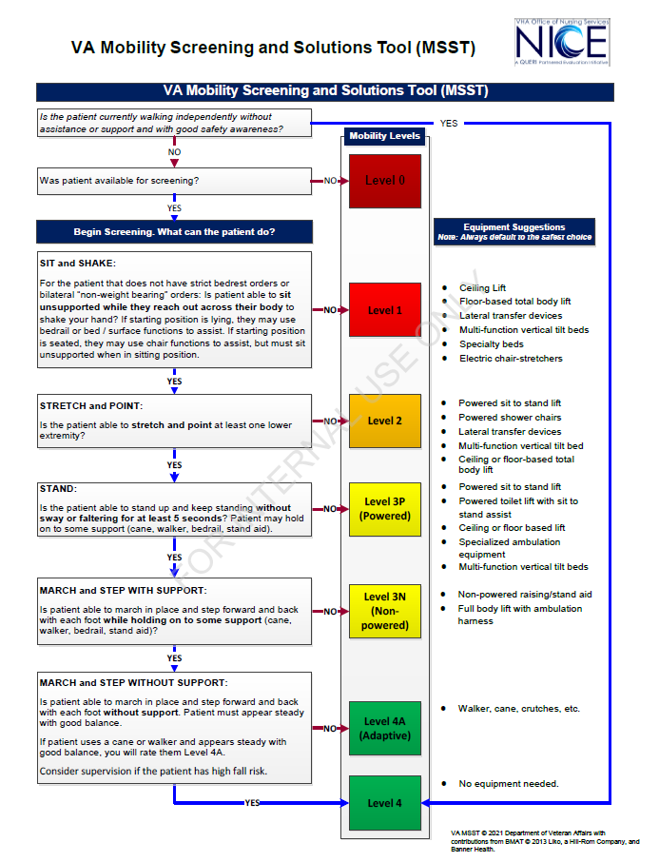

Slide 6
Using the Tool
Use VA MSST with every mobility encounter to ensure patient and staff safety. This includes all care areas (e.g. acute care, CLC, therapy, imaging, dental, HBPC, ED, etc).
Always default to the safest choice for equipment. Consider factors that may affect screening (e.g. patient’s ability to follow commands, sleep deprivation, low O2, medications, orthostatic hypotension, hypoglycemia, hypovolemia).
Remember if the answer to the 1st question is “yes”, follow blue line to Level 4.
Per VAAES ACUTE INPT AND REHAB NSG ADM SCREEN ASSESS STANDARDS OF CARE 10.20.2021.pdf (sharepoint.com), document mobility at least every shift in acute care. Follow local policy/process for frequency of documentation in other clinical areas.

Slide 7
Patient Education
Your safety is our important concern. In order to keep you and us safe, we will screen your mobility every time we go to get you up.
This helps us decide the most appropriate equipment to use, so that we can safely help you achieve your mobility goals today.
By keeping you moving safely every day, we can help you stay mobile to enjoy the activities that are most important in your life.
Staying active helps you get home.

Slide 8
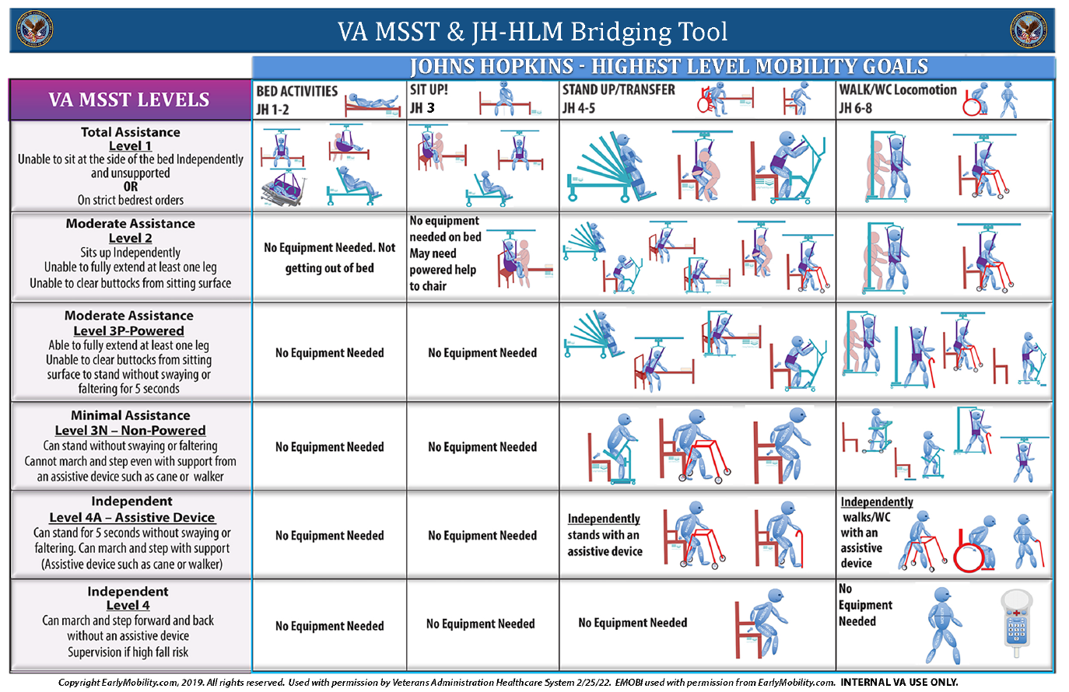

Slide 9
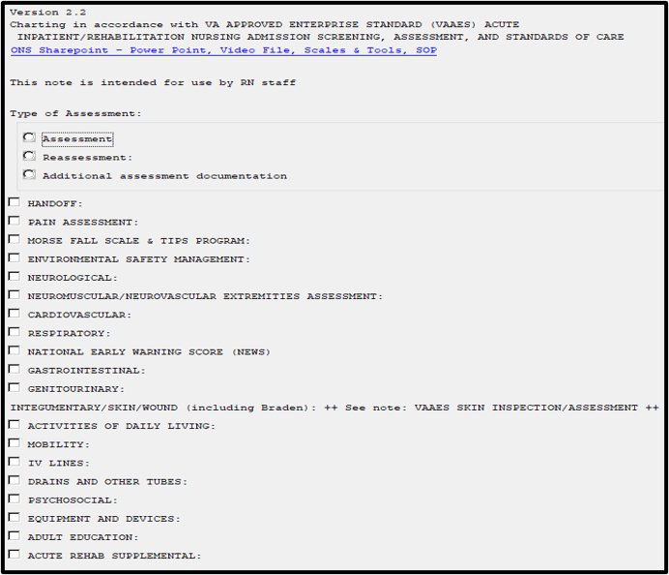
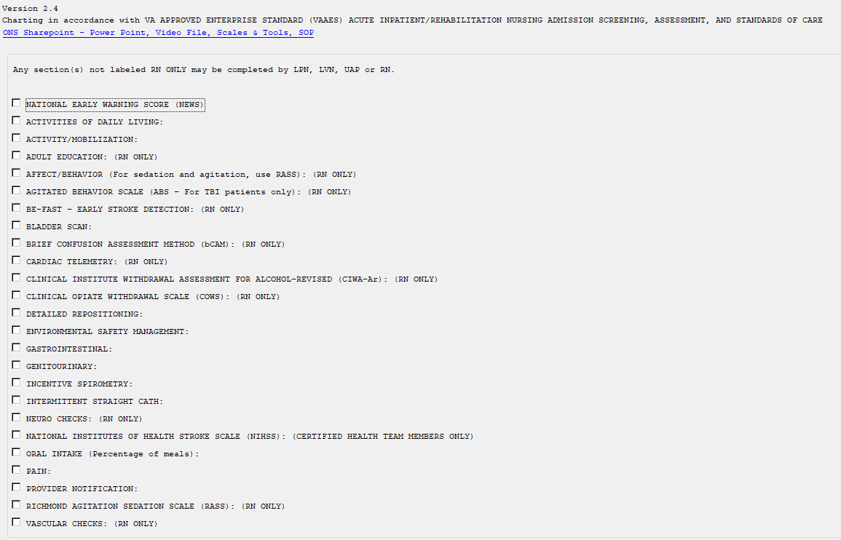
VAAES Shift Assessment and Frequent Documentation Bridging
Document mobility screen at least every shift but use VA MSST with every mobility encounter to ensure patient and staff safety

Slide 10
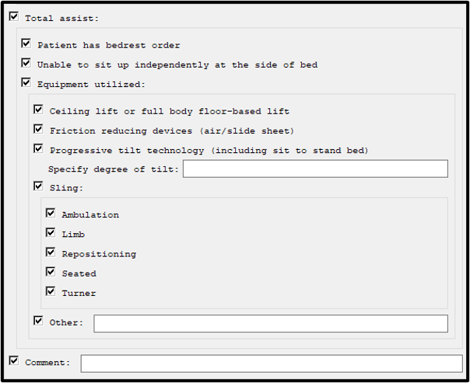
VA MSST LEVEL 1: VAAES TOTAL ASSIST
Copyright EarlyMobility.com, 2019. All rights reserved. Used with permission by Veterans Administration Healthcare System. EMOBI used with permission from EarlyMobility.com. INTERNAL VA USE ONLY
If the patient is unable to sit up independently, they require total assistance/VA MSST Level 1. This means they need help with sitting up, standing and walking.
It does NOT mean they CANNOT sit up, stand up or walk. It means they need a mechanical lift to assist them for their own safety and for the caregiver safety.
You will see that a total assistance patient can use an ambulation harness or other appropriate equipment. Imagine a patient who had a total knee replacement yesterday and needs to walk but is just a little unsteady and needs a steadying hand to sit up.

Slide 11
VA MSST LEVEL 1: VAAES TOTAL ASSIST
Copyright EarlyMobility.com, 2019. All rights reserved. Used with permission by Veterans Administration Healthcare System. EMOBI used with permission from EarlyMobility.com. INTERNAL VA USE ONLY
Your patient is waking up from sedation in ICU and is on a ventilator. They are extremely weak and cannot even begin to sit up by themselves.
  They may be able to sit with assistance of a seated sling.
  They will require total assistance.
  VA MSST Level 1.
Your patient has pneumonia and was walking yesterday but they feel lousy because they were allergic to the antibiotic given. They are dizzy at the edge of the bed. You do not feel it is safe to let them sit by themselves.
  They should be walking today but need a device in case of dizziness or falling.
  They require total assistance.
  VA MSST level 1.
Your patient has been placed on strict bedrest orders until a DVT has been ruled out.
  They require total assistance and should not get out of bed.

Slide 12
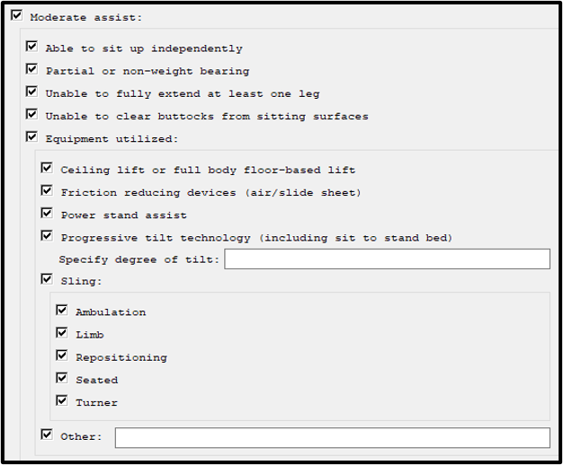
VA MSST LEVEL 2: VAAES MODERATE ASSIST
Copyright EarlyMobility.com, 2019. All rights reserved. Used with permission by Veterans Administration Healthcare System. EMOBI used with permission from EarlyMobility.com. INTERNAL VA USE ONLY
If the patient CAN sit up independently, the next question is if they have the strength to try and stand up.
The Stretch and Point step is a very important step which is why it has its own whole category in the screen.
Traditionally, staff would try to have a patient stand up without doing this step and many staff injuries and falls occur with patient knees buckling.
If they are unable to stretch at least one leg to almost straight and point their toes, they are moderate assistance, level 2.
This means they require power to even try and stand up because they lack the strength in their legs to safely try to stand without a device.
It does NOT mean they CANNOT stand up or walk. It means they need a mechanical lift to assist them for their own safety and for caregiver safety.

Slide 13
VA MSST LEVEL 3P (POWERED): VAAES MODERATE ASSIST
Copyright EarlyMobility.com, 2019. All rights reserved. Used with permission by Veterans Administration Healthcare System. EMOBI used with permission from EarlyMobility.com. INTERNAL VA USE ONLY
If the patient CAN sit up independently and has the strength and movement in at least one leg to try and stand up, the next question is to see if they can stand safely on their own.
If they are unable to clear their buttocks, you know they need power to stand.
The patient will be level 3P but still require moderate assistance to stand.
Many have asked why not just combine level 2 and level 3P. The reason for this is that this would result in the stretch and point being skipped over.
The patient must be able to stretch and point AND stand without losing balance to pass to the 3N (minimal assist category) and BOTH level 2 and level 3P require moderate assist to stand and walk (power) but a level 2 lacks leg strength, a level 3P can try to stand but lacks glute strength to clear buttocks.
The Stretch and Point step is a very important step which is why it has its own whole category in the screen.
Notes:
The goal is to keep everyone safe. There may be sometimes where the patient can clear their buttocks and stand but are a little unsteady. In this case the patient should have power to keep them safe.
Though the VAAES notes say the patient can be unsteady and require minimal assistance, for the MSST, if the patient is unsteady, caregivers should default to powered assist. Remember that the MSST is for ALL Disciplines, including unlicensed staff to ensure everyone is safe. If it was designed for one discipline only, it would have looked different. There may be sometimes when this patient may not be using power, but the intent of the tool is to keep all safe and if in doubt, defaulting to power keeps everyone safe.

Slide 14
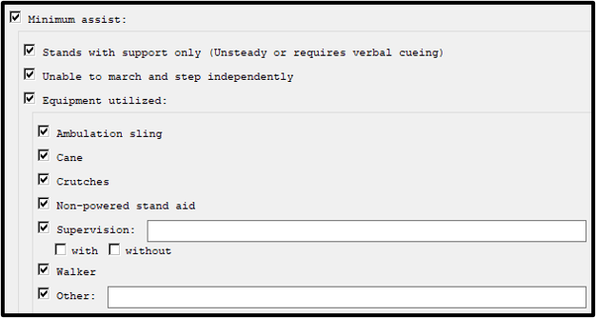
VA MSST LEVEL 3N (NON-POWERED): VAAES MINIMAL ASSIST
Copyright EarlyMobility.com, 2019. All rights reserved. Used with permission by Veterans Administration Healthcare System. EMOBI used with permission from EarlyMobility.com. INTERNAL VA USE ONLY
If the patient CAN sit up independently, has good leg strength and is able to clear their buttocks from the surface to stand without loss of balance for 5 seconds, with or without an assistive device, the next question is whether they can safely walk.
If they are unable to pick up their feet to march in place and take steps forward and back with each foot, they are VA MSST Level 3N/VAAES minimum assist.
Remember if they cannot stand safely without loss of balance for 5 seconds, they remain a level 3P.
Level 3N patients need non-powered stand aid for mobility/locomotion but might use walker for stand up/simple transfer.
Notes:
Again, though the VAAES notes say the patient can be unsteady and require minimal assistance, for the MSST, if the patient is unsteady, caregivers should default to powered assist. Remember that the MSST is for ALL Disciplines, including unlicensed staff to ensure everyone is safe. If it was designed for one discipline only, it would have looked different. There may be sometimes when this patient may not be using power, but the intent of the tool is to keep all safe and if in doubt, defaulting to power keeps everyone safe.

Slide 15
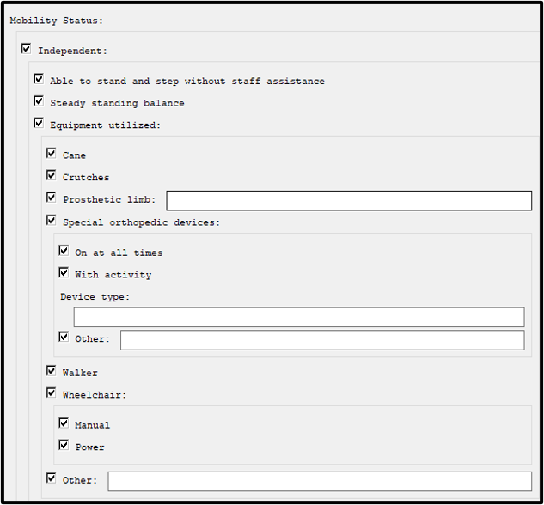
VA MSST LEVEL 4A (ADAPTIVE) : VAAES INDEPENDENT
Copyright EarlyMobility.com, 2019. All rights reserved. Used with permission by Veterans Administration Healthcare System. EMOBI used with permission from EarlyMobility.com. INTERNAL VA USE ONLY
If the patient can march in place and step forward and back safely using adaptive device but not without device, they are independent with adaptive device so VA MSST Level 4A/VAAES independent.
If patient is independent with wheelchair, they are also VA MSST Level 4A/VAAES independent
There may be some instances in structured rehabilitation such as working on balance or high-level gait activities where therapists may use ambulation harnesses or equipment to push activities.
Supervision needed if high fall risk.

Slide 16
VA MSST LEVEL 4: VAAES INDEPENDENT
Copyright EarlyMobility.com, 2019. All rights reserved. Used with permission by Veterans Administration Healthcare System. EMOBI used with permission from EarlyMobility.com. INTERNAL VA USE ONLY
If the patient can march in place and step forward and back safely without an adaptive device, they are VA MSST Level 4/independent.
Supervision needed if high fall risk.

Slide 17
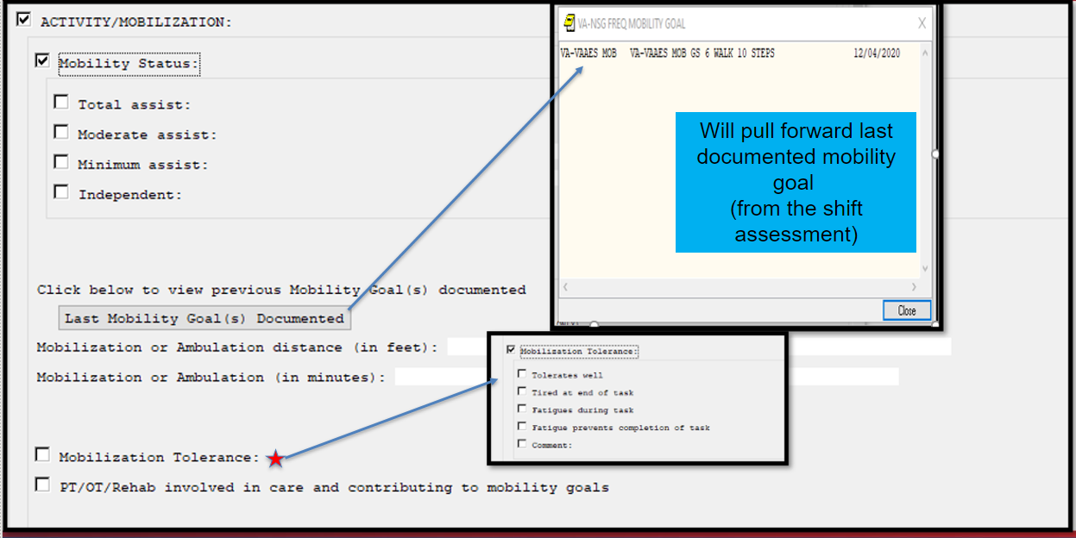
Activity/Mobilization
(Located in the VAAES nursing FREQUENT DOCUMENTATION NOTE)

Slide 18
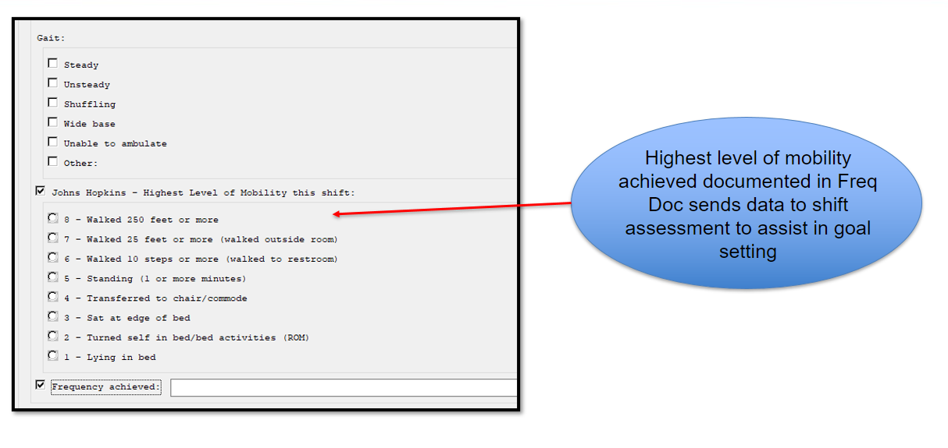
Activity/Mobilization
(Located in the VAAES nursing FREQUENT DOCUMENTATION NOTE)

Slide 19
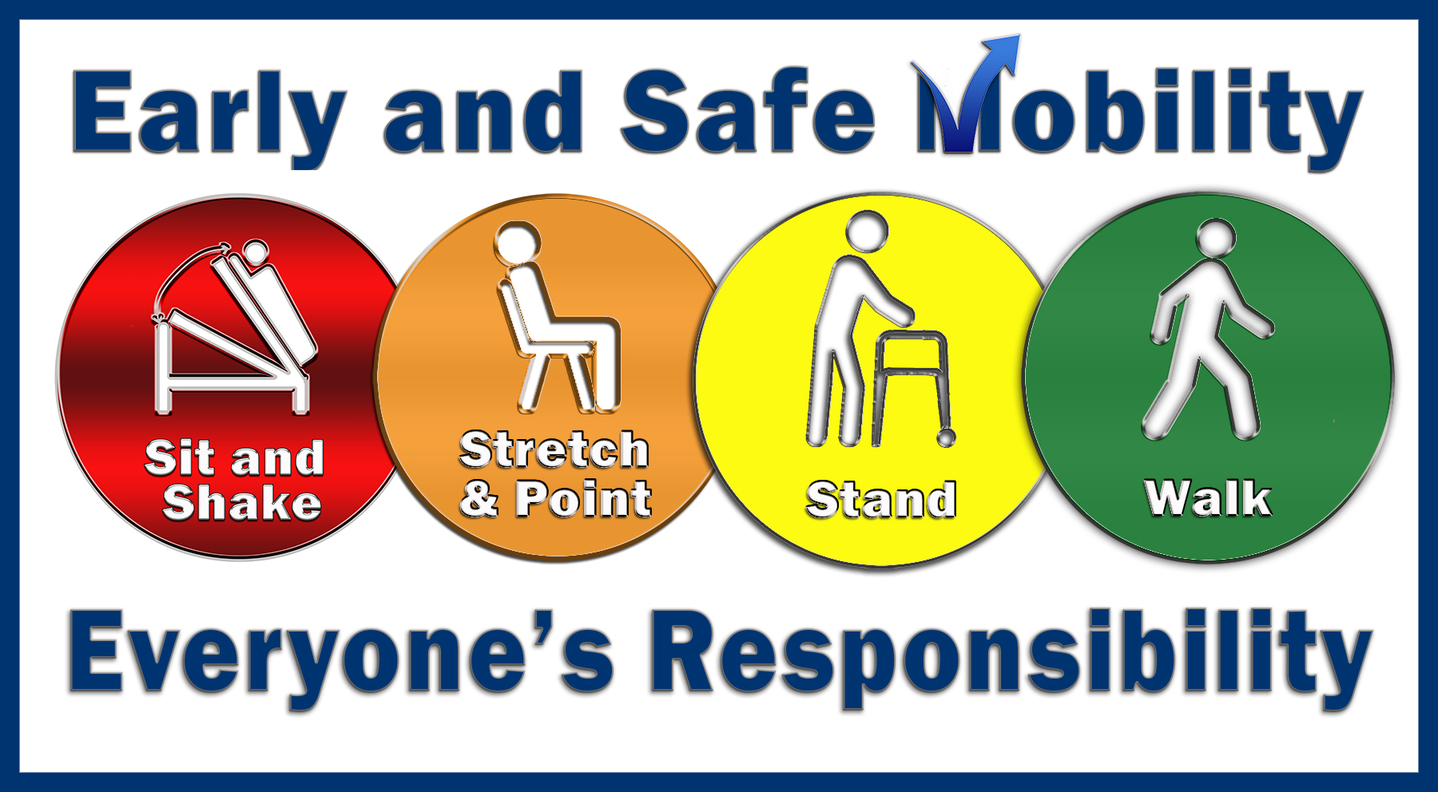

Slide 20
Video Resources
Introduction to MSST YouTube link: https://youtu.be/I9PPs2SB7zU
Scenarios that were used for the testing:
https://dvagov.sharepoint.com/sites/vhasafe-patient-handling-and-mobility/SPHM%20Videos/Forms/AllItems.aspx?newTargetListUrl=%2Fsites%2Fvhasafe%2Dpatient%2Dhandling%2Dand%2Dmobility%2FSPHM%20Videos&viewpath=%2Fsites%2Fvhasafe%2Dpatient%2Dhandling%2Dand%2Dmobility%2FSPHM%20Videos%2FForms%2FAllItems%2Easpx&id=%2Fsites%2Fvhasafe%2Dpatient%2Dhandling%2Dand%2Dmobility%2FSPHM%20Videos%2FVA%20MSST%20Training%20Videos&viewid=3e883fee%2D2979%2D401b%2Dbc7e%2De2e49d61840b

